Slide 1
Lending club – Case study
Exploratory DATA ANALYSIS
Vishak V
Vinayak varma

Slide 2
Problem Statement
What we understand
Our consumer is a finance company, specializing in various types of loans for urban customers, faces critical decisions when approving loan applications. The primary risks involved are:
Business Loss : Not approving a loan for an applicant who is likely to repay results in a missed business opportunity.
Financial Loss : Approving a loan for an applicant who is likely to default leads to credit loss, which occurs when the borrower fails to repay the loan.
Objective
To identify key factors that indicate the likelihood of loan default among applicants, enabling the company to mitigate credit loss by making informed lending decisions.

Slide 3
Assumptions and Considerations
All the customers in the data set were had their loan approved and we are analyzing all the three categories of Fully paid, Current and Charged off.
Out of all the attributes/variables available we kept only those which we have done background research for and found valid data available in the data set
To ensure missing data doesn’t provide any bias for the results have excluded those from the data for analysis
Manually did some correlation analysis which helped in selecting most relevant and important variables to be considered. Did some research to consider generic points from risk perspective as well.

Slide 4
Approach followed
Data Loading & Cleaning
01
Inspected the data by taking a look at the first few rows to understand the structure and content of the dataset
Loaded the raw data to notebook
Checked for missing values and removed all columns having null and NA values
Research & Data Analysis
02
Replaced all the missing values with ‘Mean’ value of the same column
From independent research about risk analytics finalized 14 variables from the 48 variables remaining from cleaning steps which we found would be suitable for analysis.
Focused on those attributes for performing further analysis

Slide 5
Approached followed
Univariate Analysis
03
Analyzed the distribution of numerical variables (e.g., loan amount, interest rate, annual income).
Used histograms and bar charts to visualize the distribution of numerical and categorical variables.
Bivariate Analysis
04
Used scatter plots for numerical variables and stacked bar charts or heatmaps for categorical variables.
Did many random variable analysis to deduce some important information related to the data available
Multivariate Analysis
05
Visualized multiple variables using a single pair plot for analysis

Slide 6
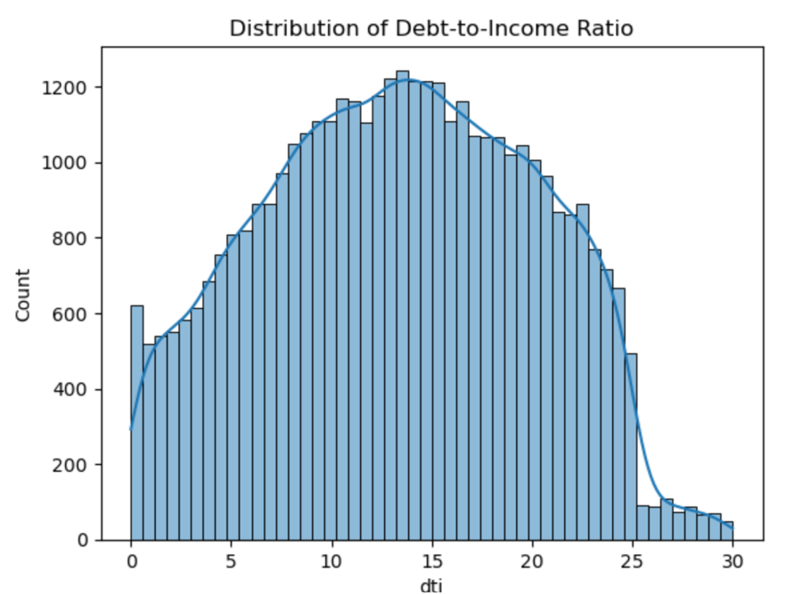
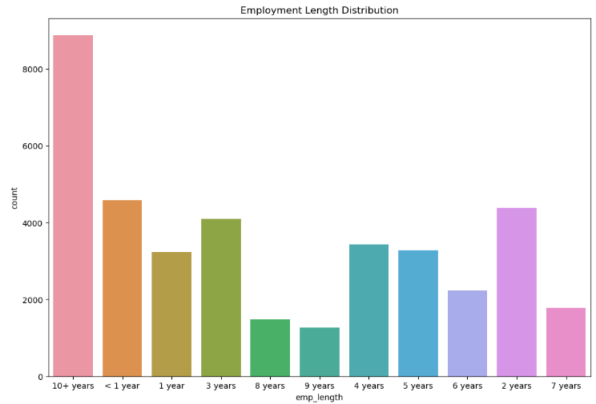
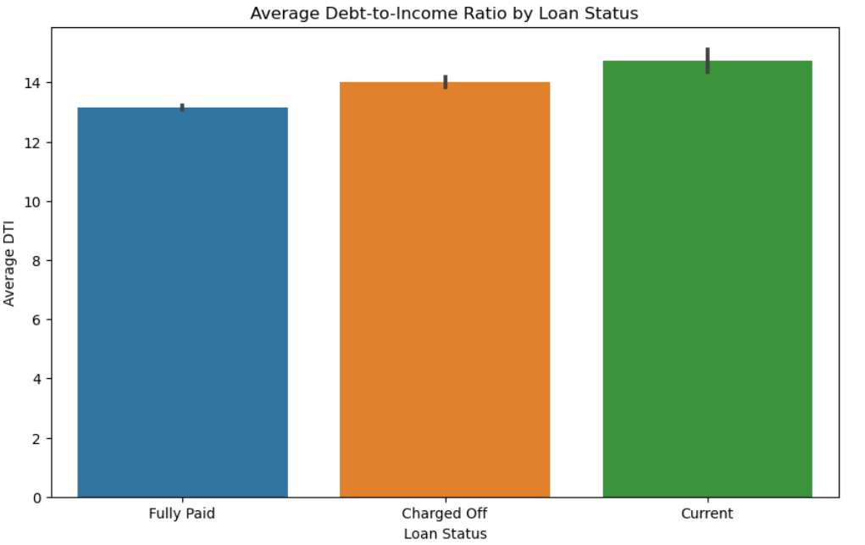
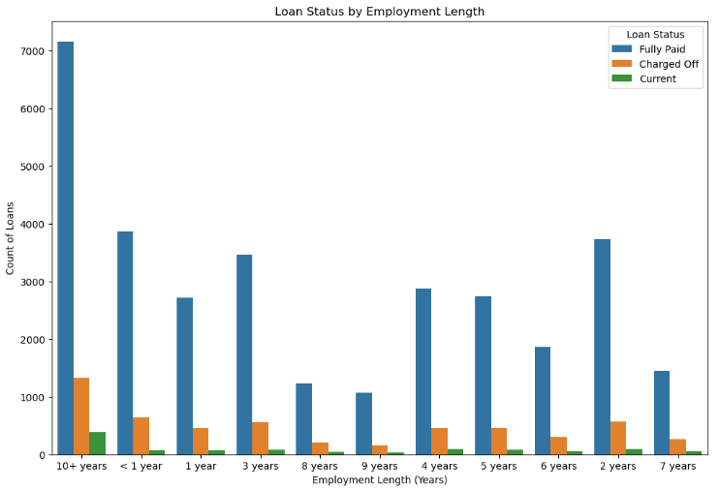
Results and Observations
A higher DTI indicates a higher debt burden, which could lead to a higher risk of default.
Here we can see that dti is mostly <15 and it is advisable to provide loan to people with DTI less than 13
Borrowers with longer employment histories are considered to have a more stable income and are less likely to default.

Slide 7
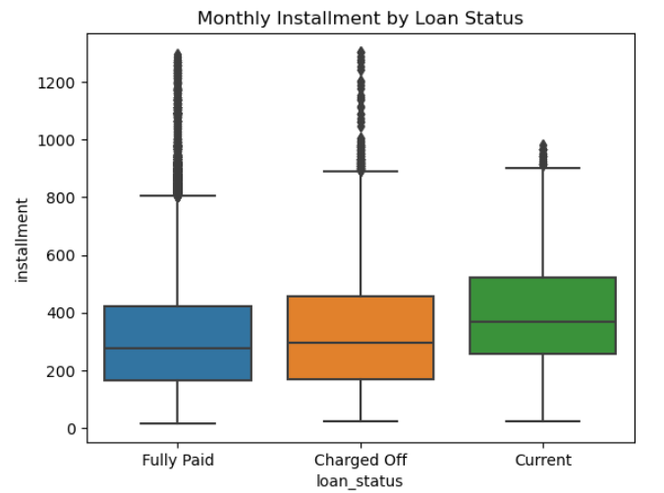
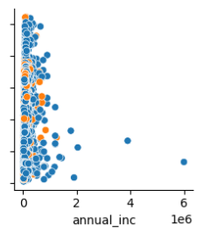
Results and Observations
It can be seen that monthly installment within a range of 200-400 have higher probability of repayment.
The monthly payment amount relative to the borrower’s income can impact their ability to make consistent payments.

Slide 8
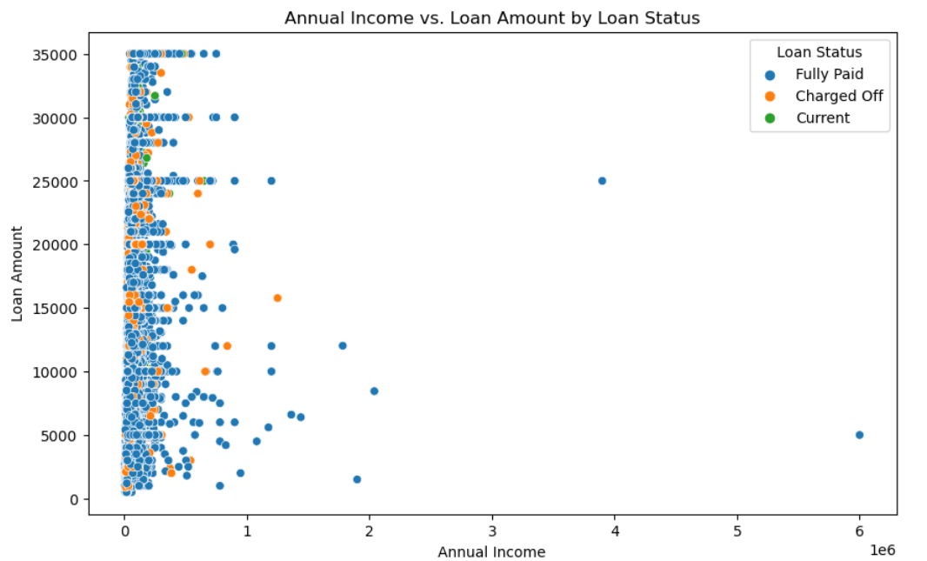
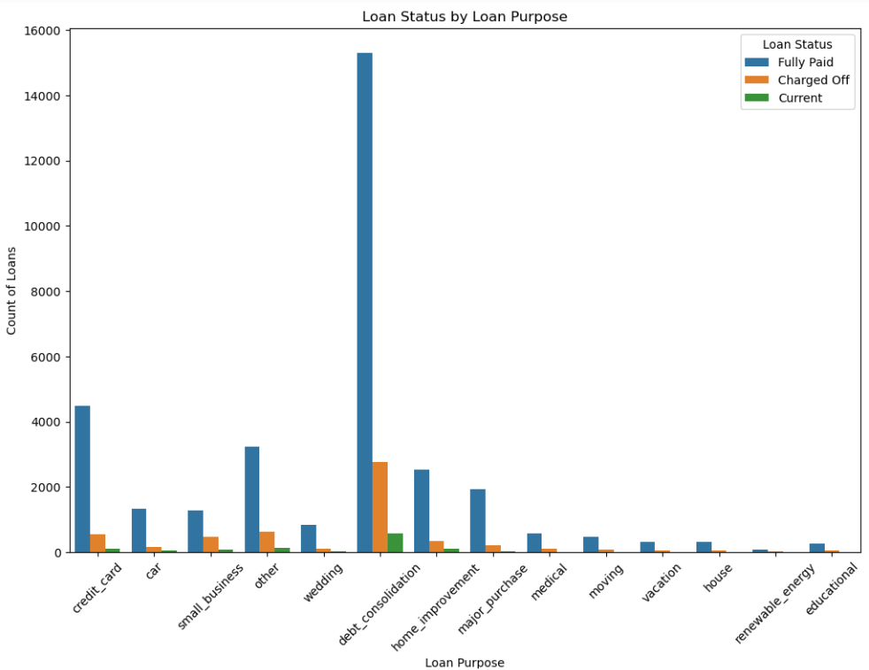
Results and Observations
The size of the loan compared to the borrower's income can be an indicator of the borrower's ability to repay.
Larger loans relative to lower income indicate a higher risk of default.
Lower loan amounts are less likely to be defaulted from the above plot.
The above plot gives an idea that people who take loan for debt consolidation are higher and are likely to repay it and mostly people takes loans for the same purpose.

Slide 9
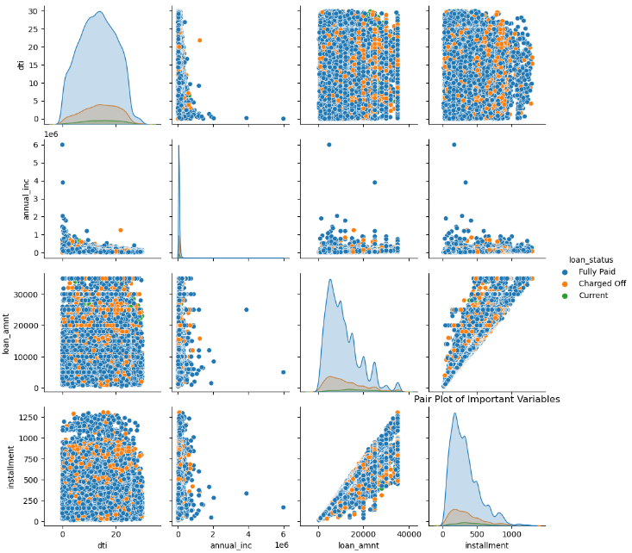
Results and Observations
Has a direct correlation between Loan amount and installment and defaulting. Higher the loan amount higher the installment and higher probability of default
Cap loan amounts at a certain percentage of the borrower’s annual income, which can help in lower risk of defaulting.

Slide 10
Recommendations for Risk Mitigation
Implement stricter lending criteria for applicants with DTI >13. Consider adding higher interest rates or collaterals for them.
Give preference to applicants with higher Emplyment Length. Additional verfications to be implemented in place for shorter length.
Higher the annual income default rates are likely to be lesser.
Loan amount can be capped to a certain limit compared to applicant’s annual income.
Eventhough most of the loans are taken for the purpose of debt consolidation, its recommended to diversify and provide for purposes such as Housing Loan or Home improvement categories

Slide 11
Thank you

